Slide 1
Django Geeky Show
by Dpu Barman

Slide 2
1. What is Framework

Slide 3
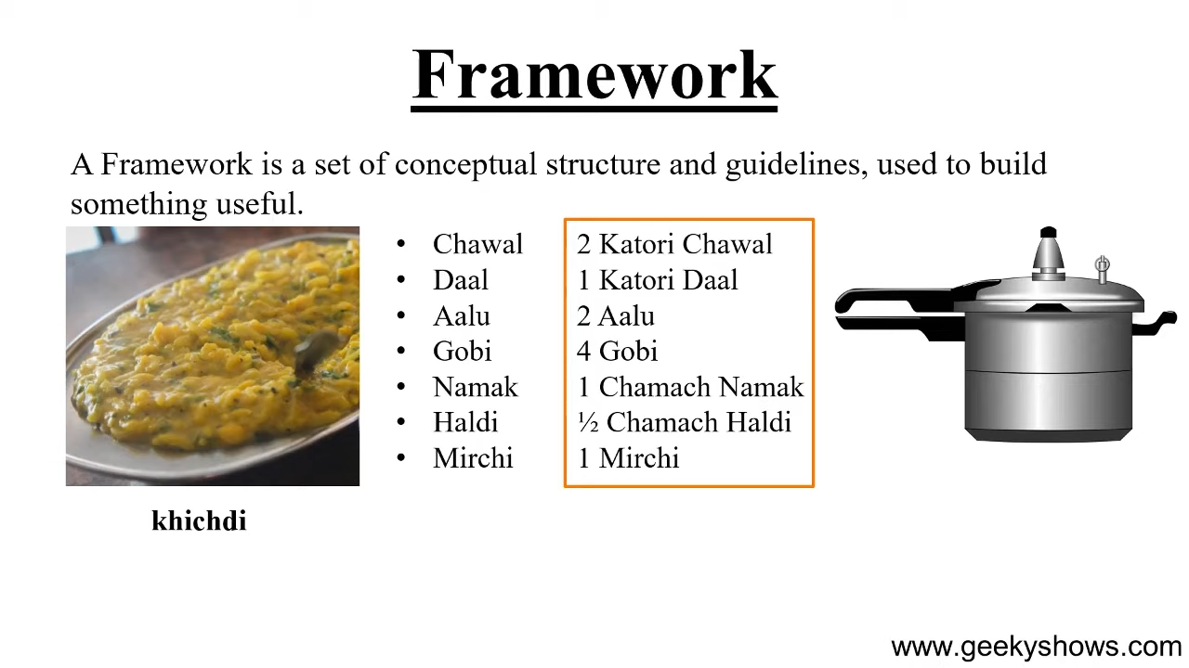

Slide 4
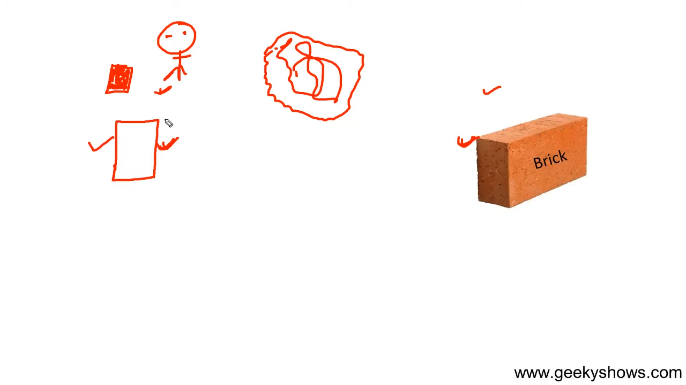

Slide 5
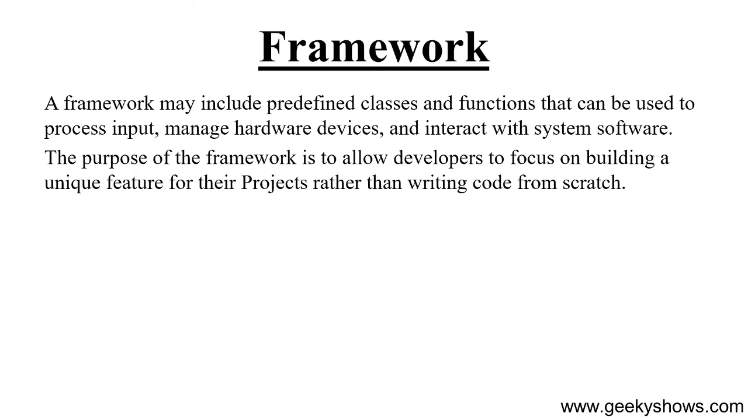

Slide 6
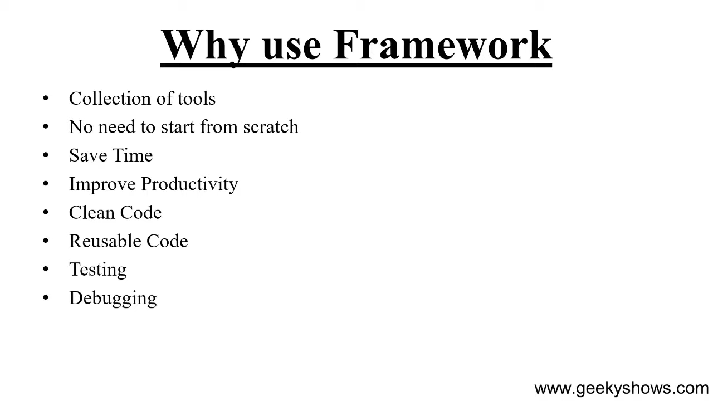

Slide 7
2. What is Web Framework

Slide 8
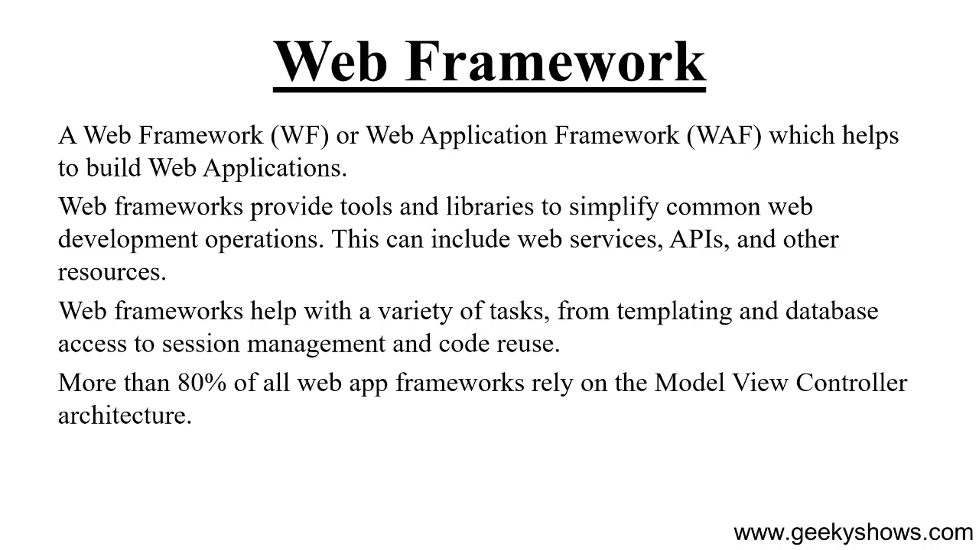

Slide 9
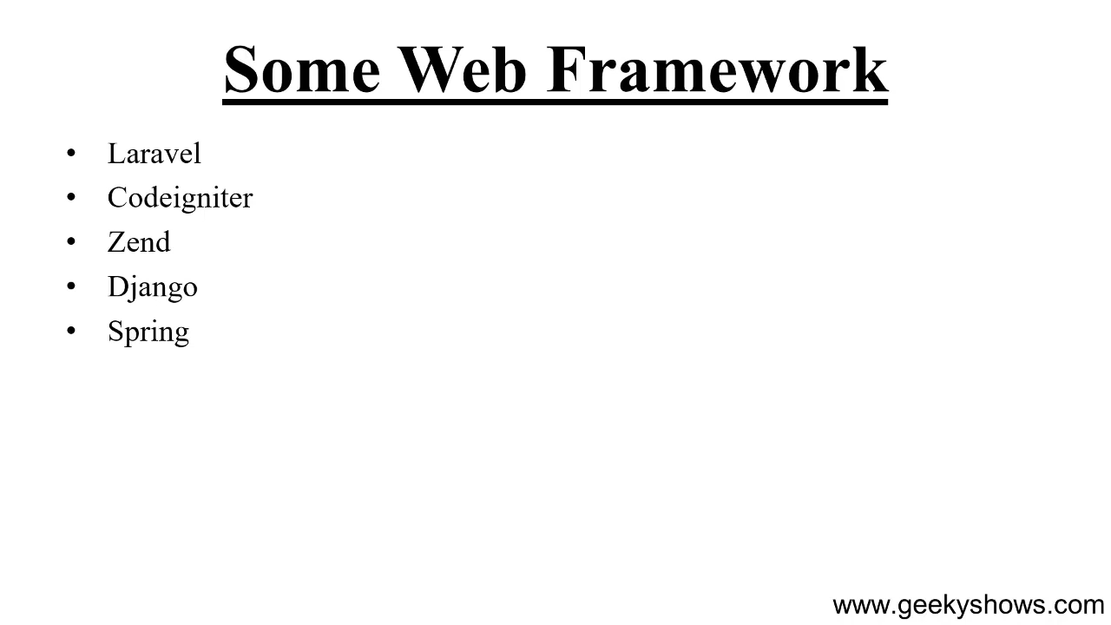

Slide 10
3. What is Model View Template

Slide 11
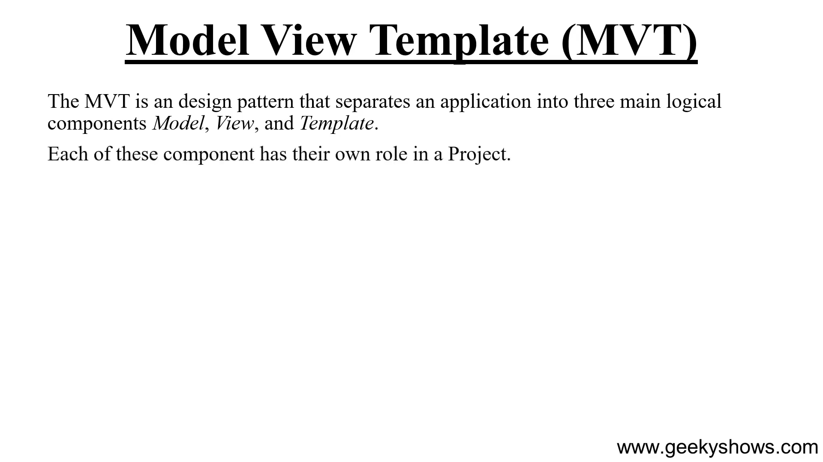

Slide 12
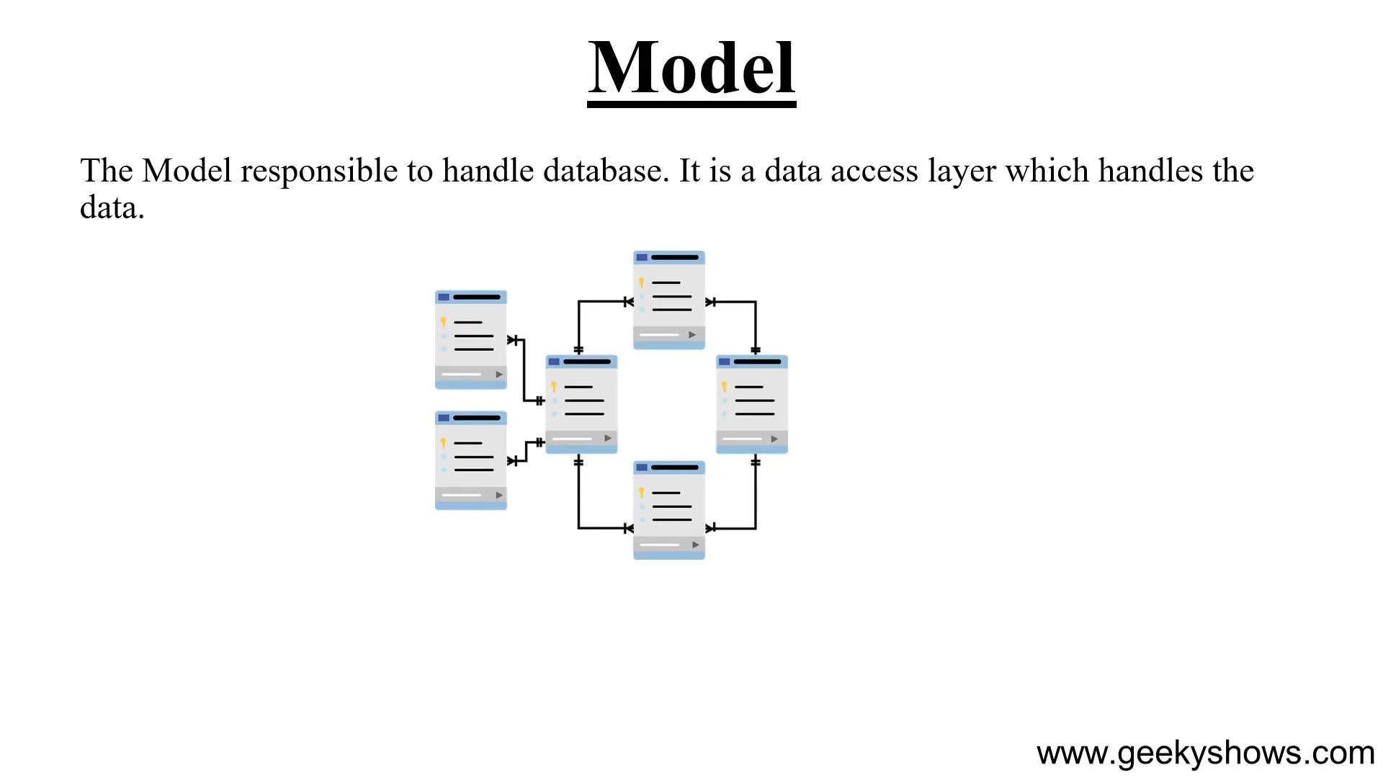

Slide 13
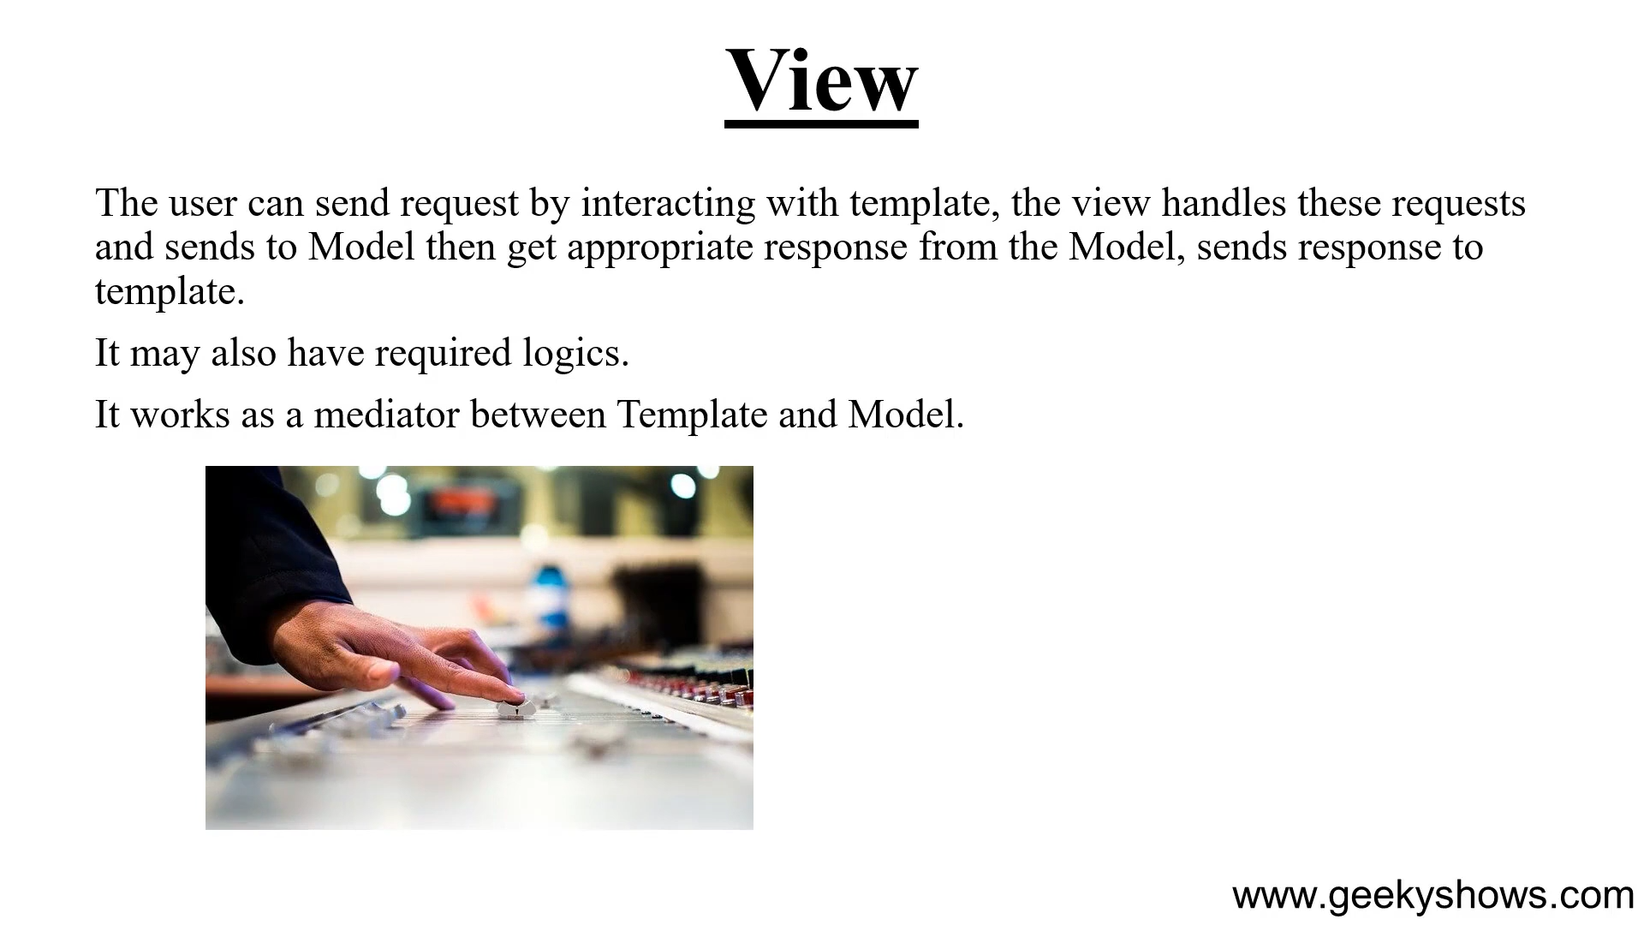

Slide 14
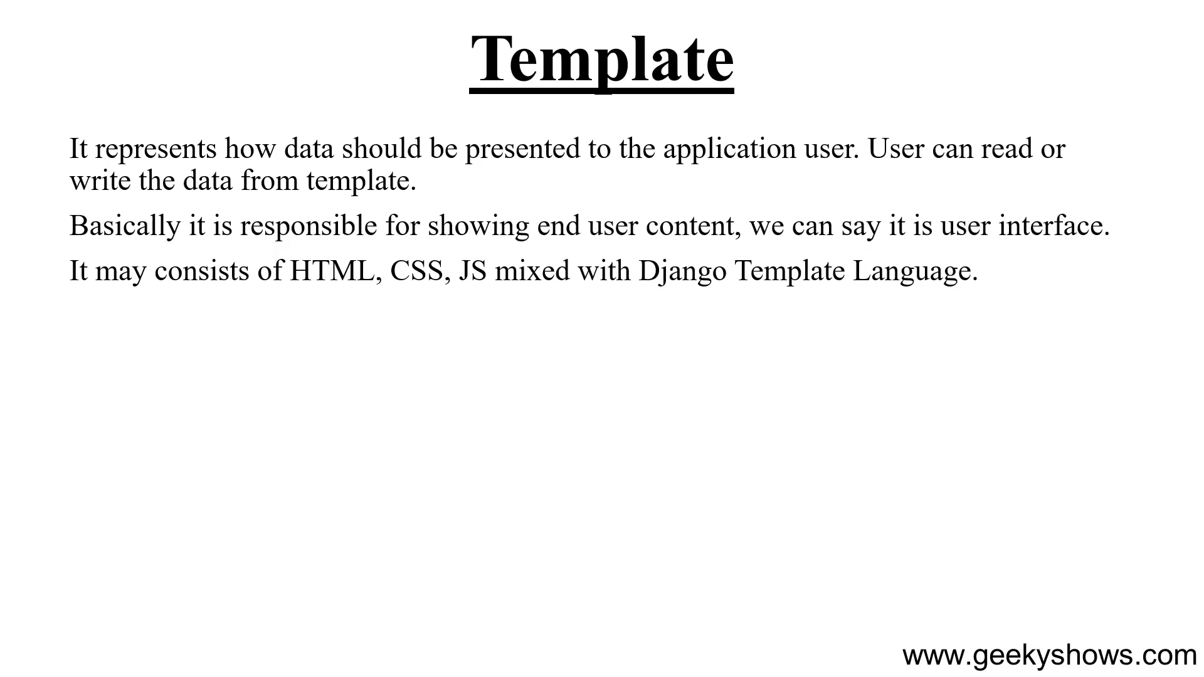

Slide 15
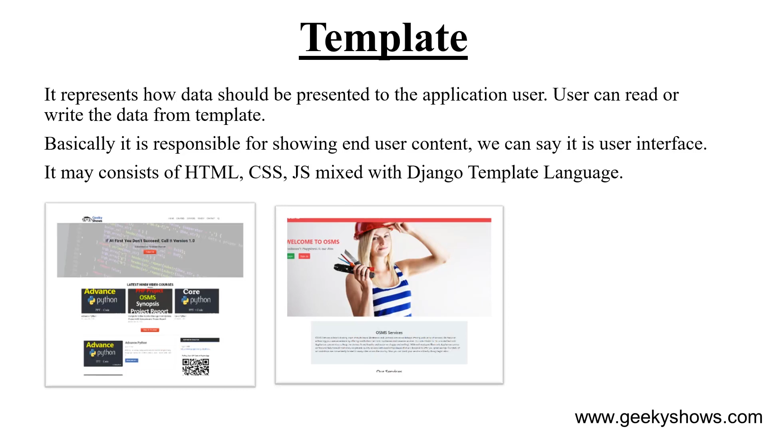

Slide 16
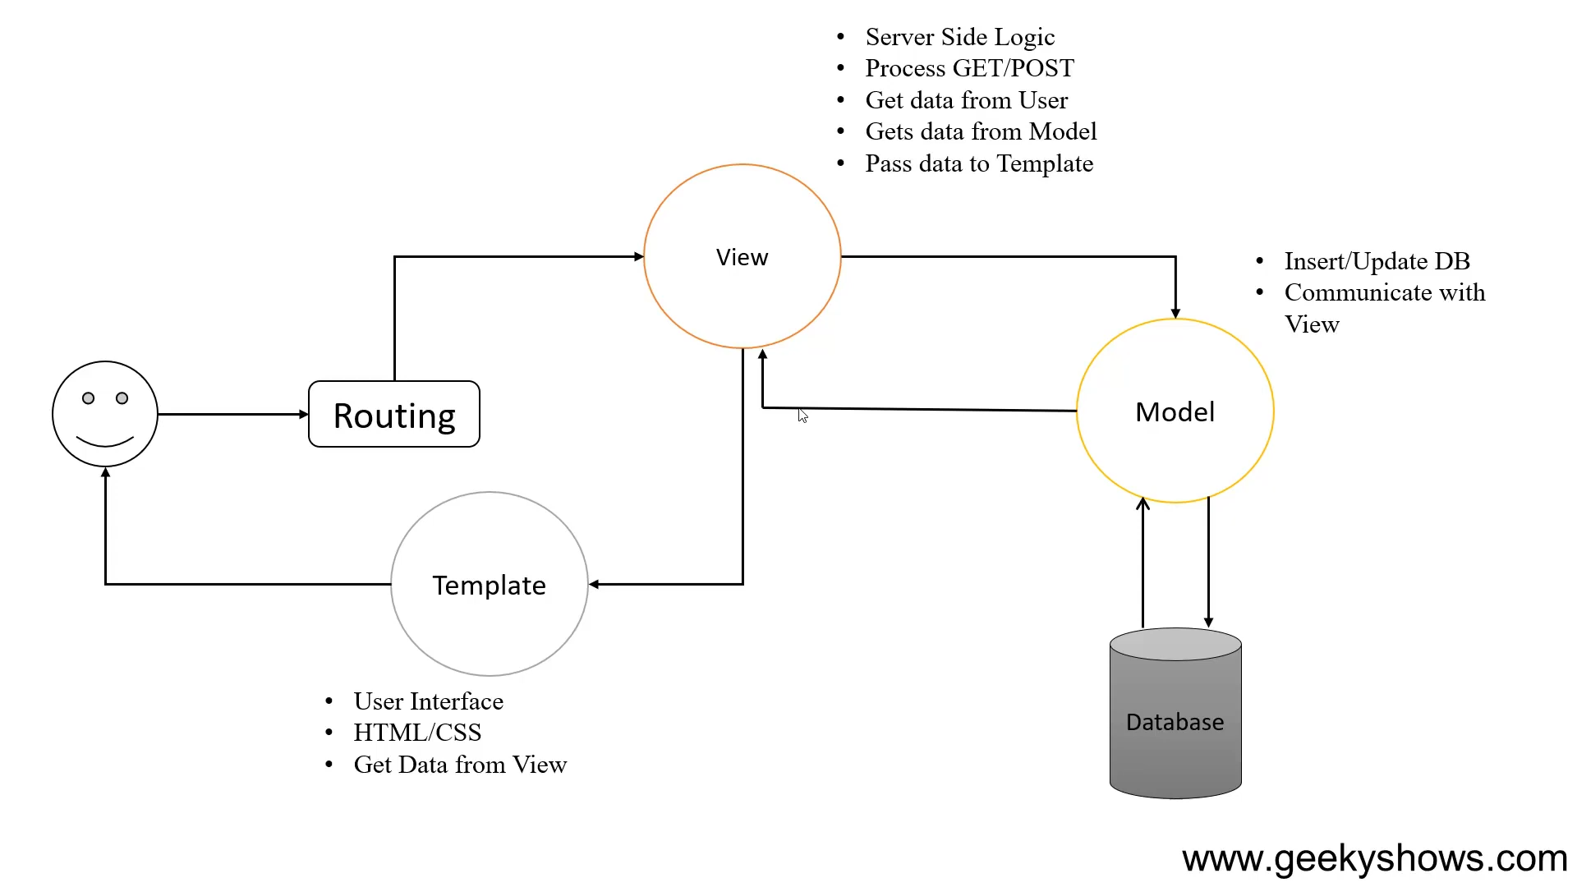

Slide 17
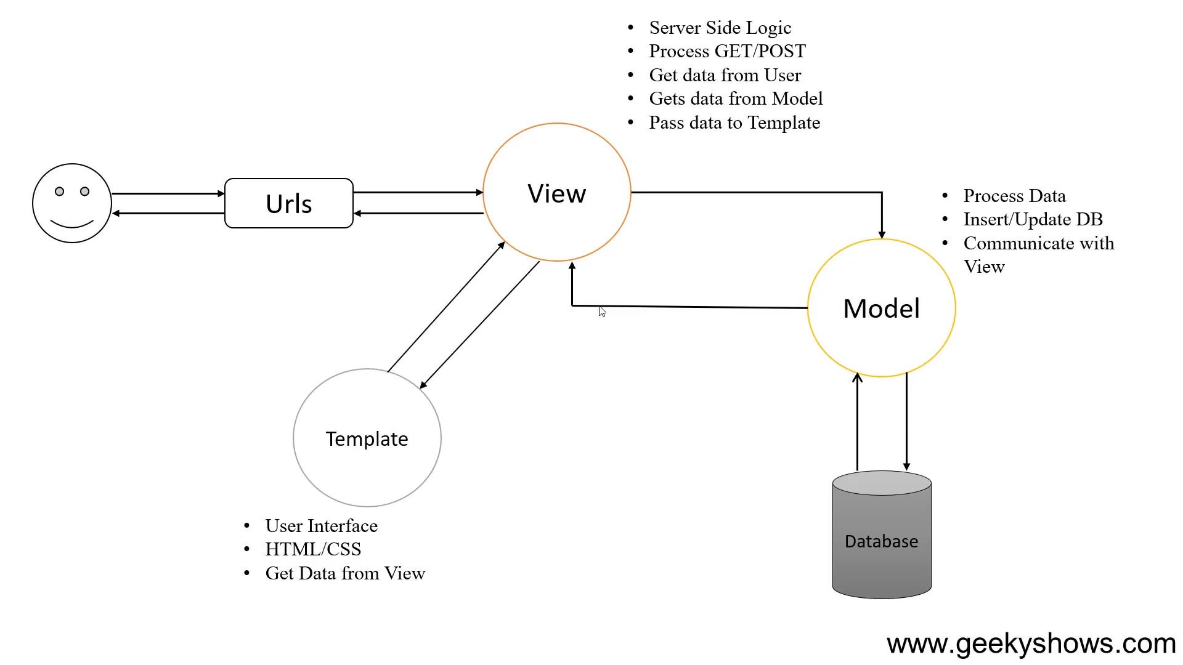

Slide 18
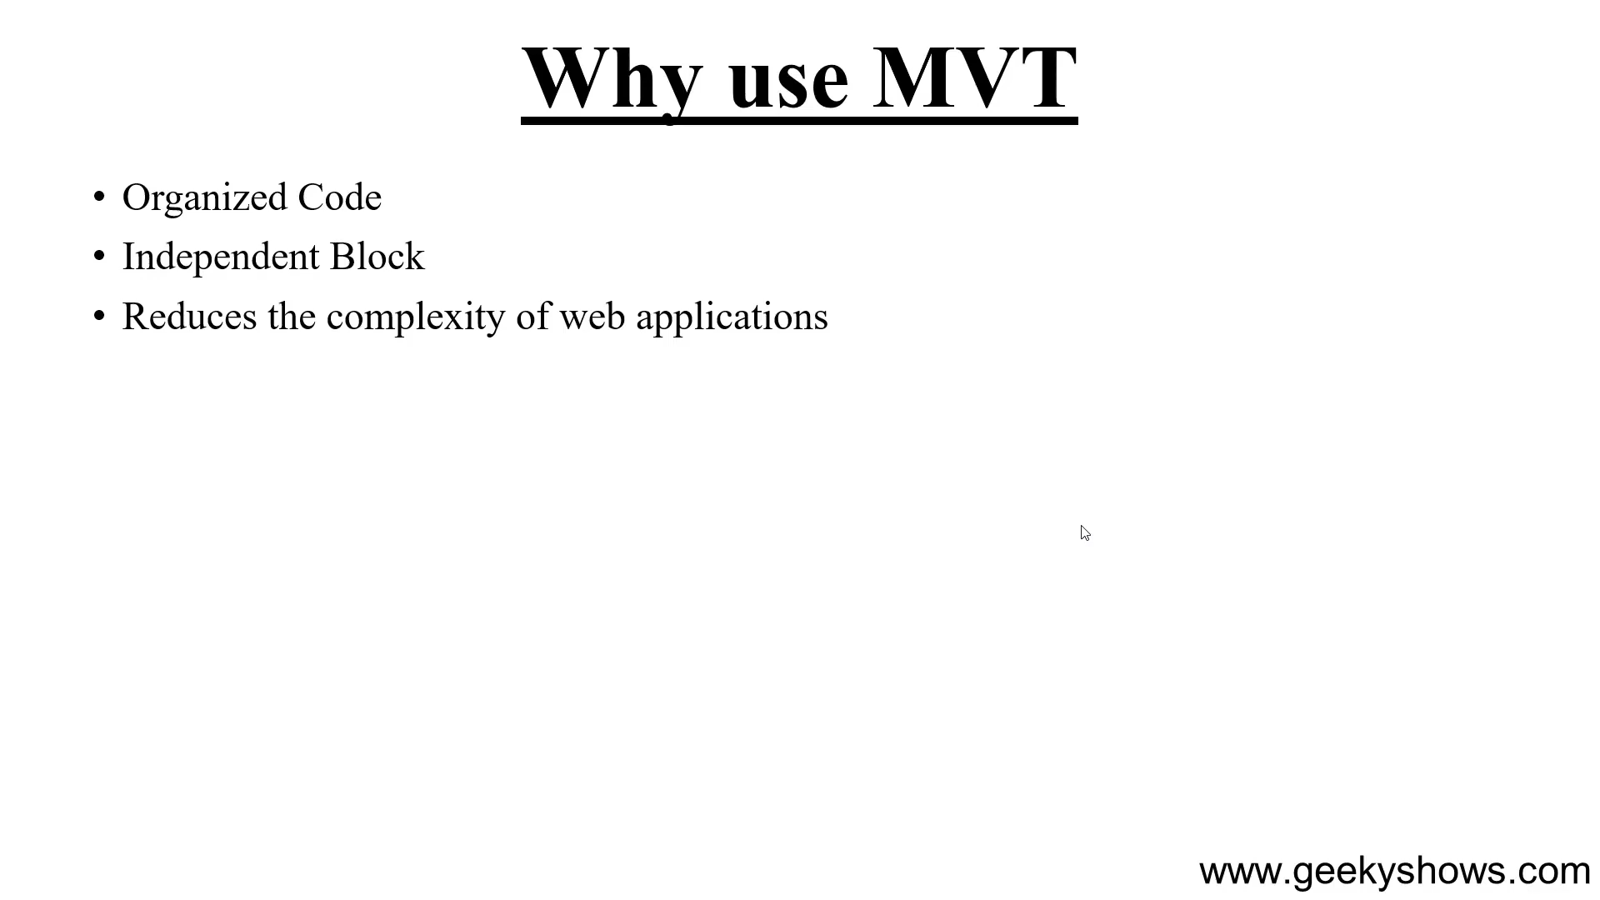

Slide 19
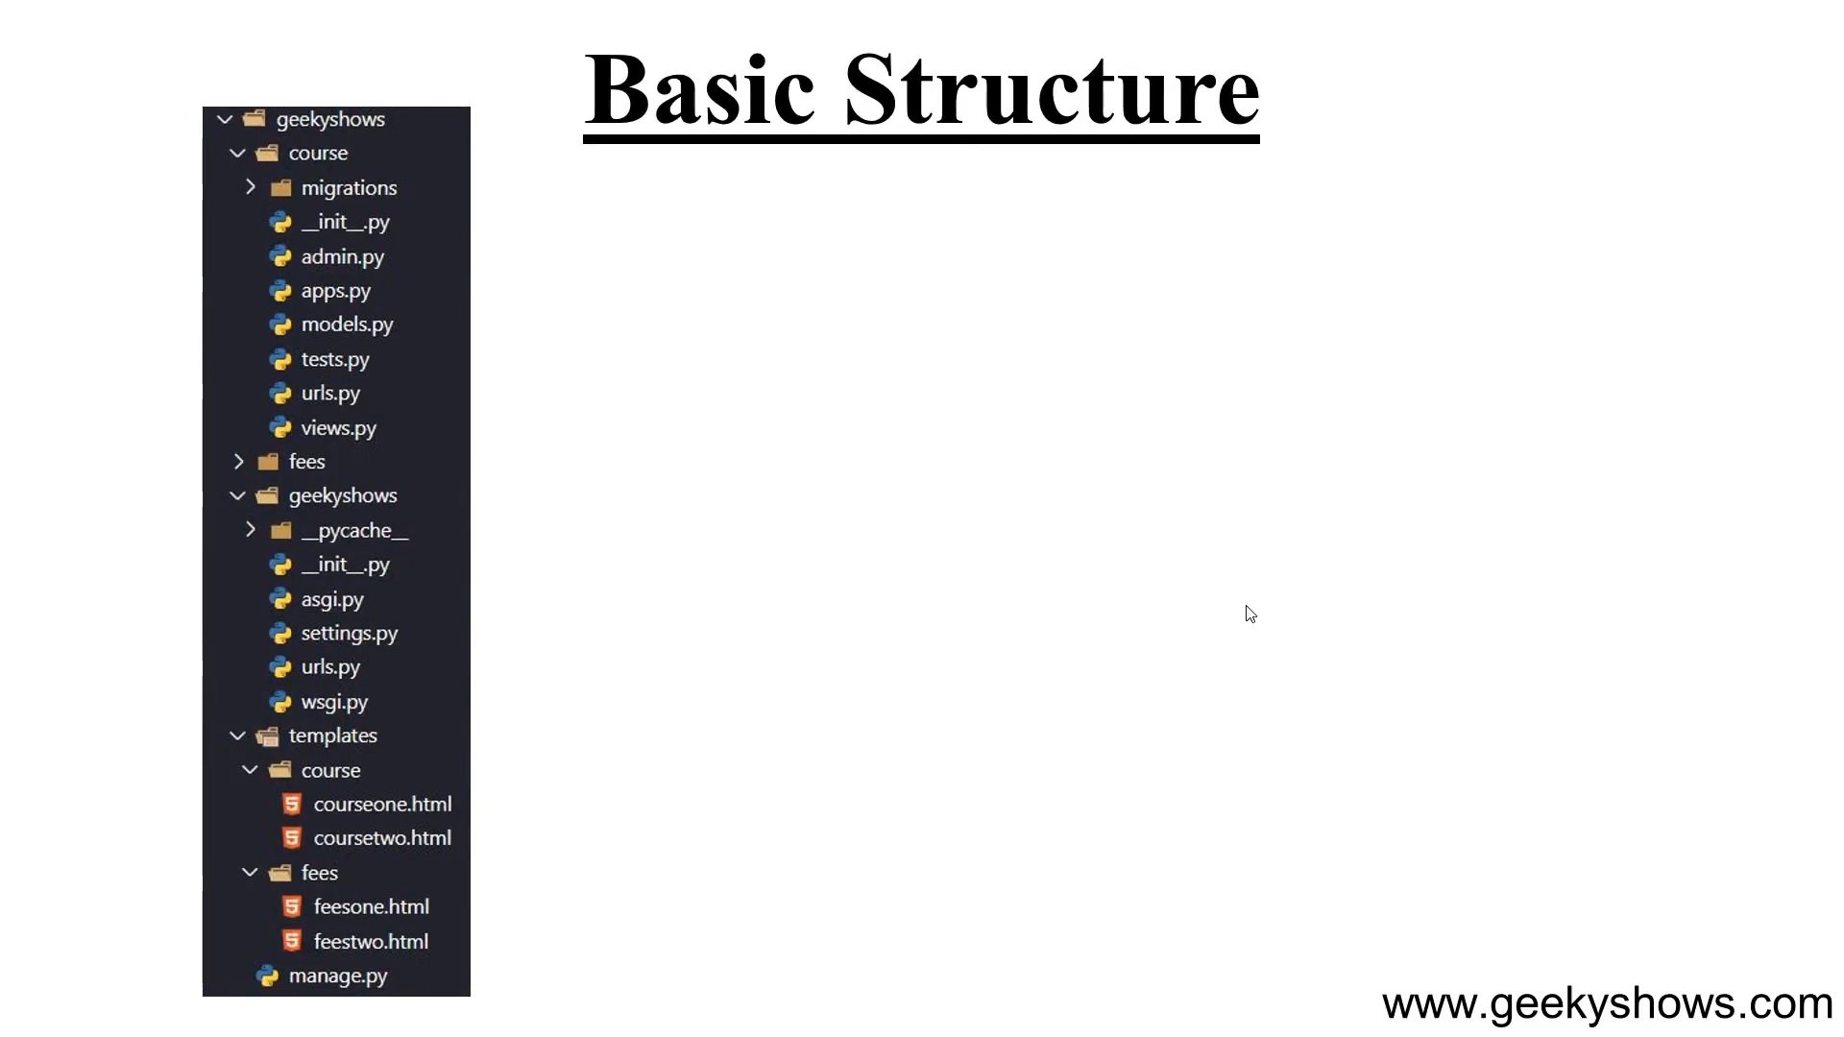

Slide 20
4. Introduction to Django

Slide 21
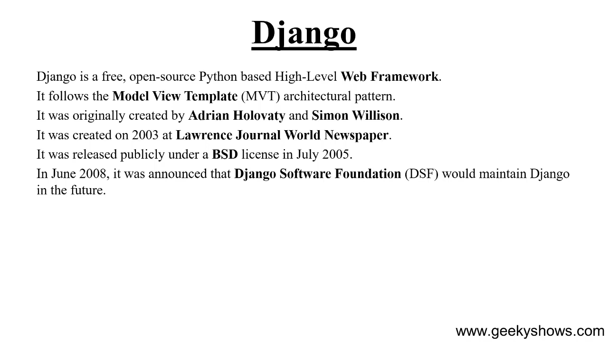

Slide 22
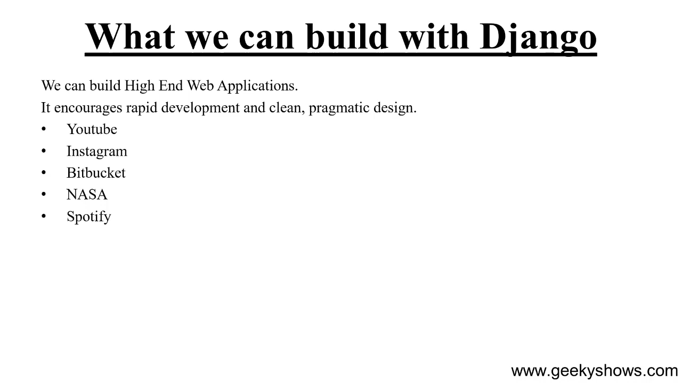

Slide 23
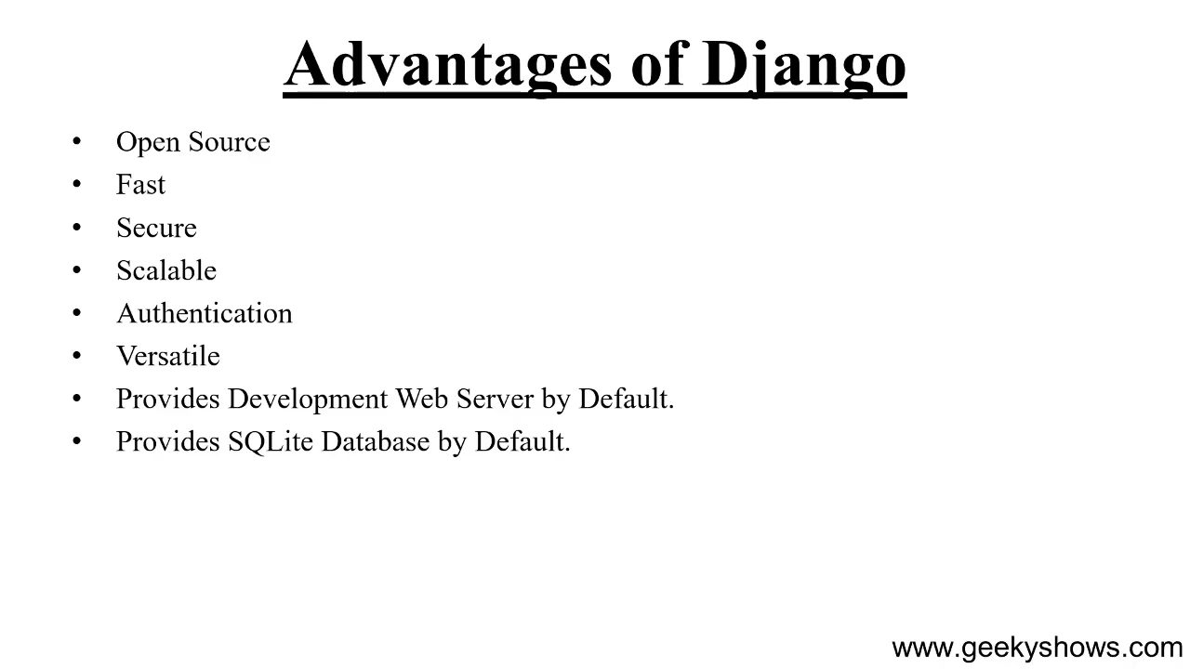

Slide 24
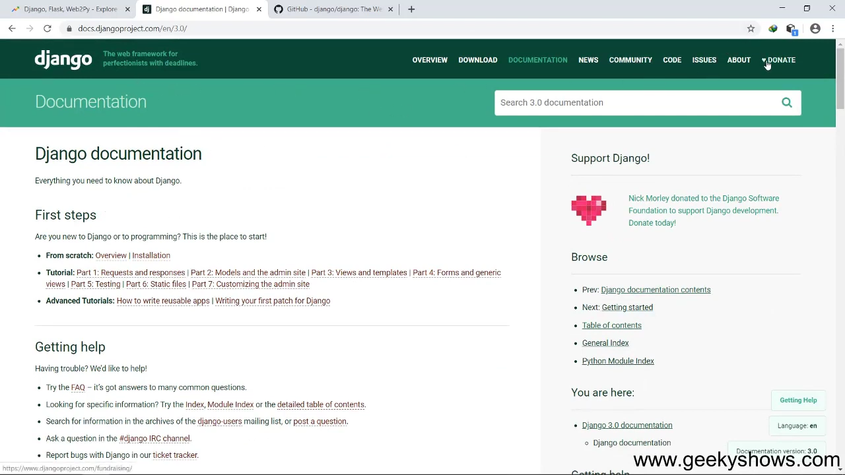

Slide 25
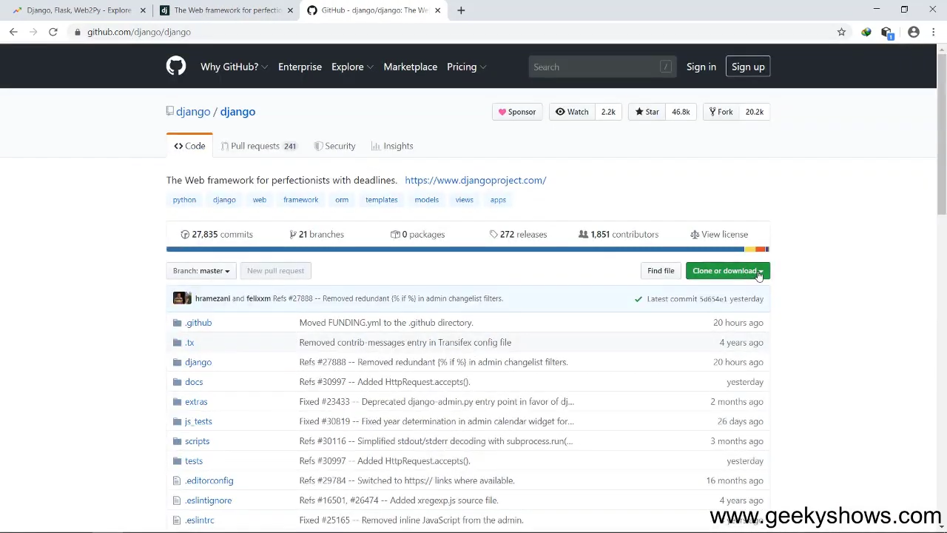

Slide 26
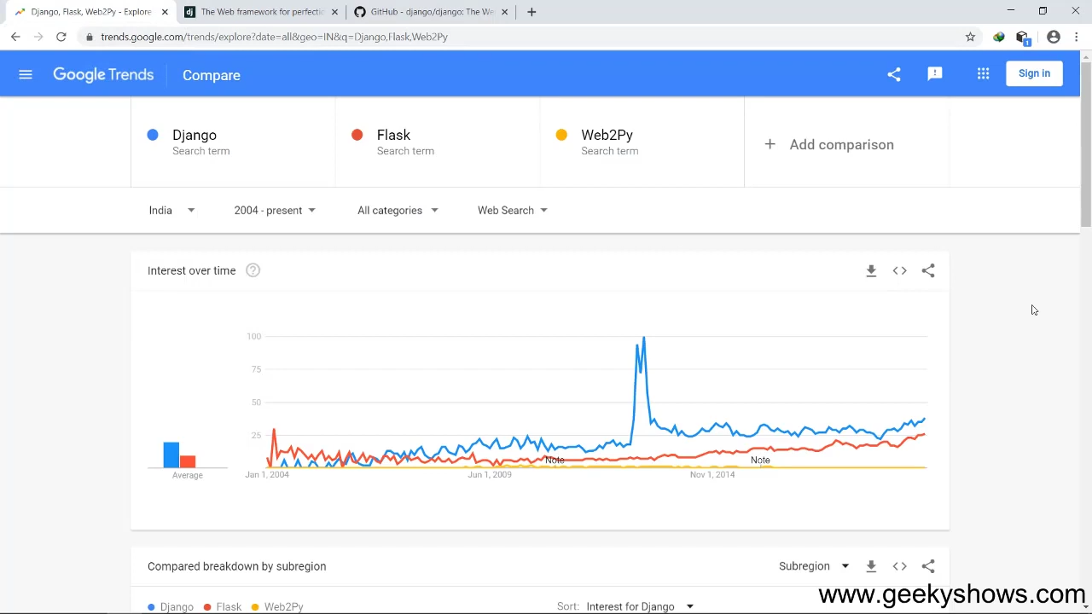

Slide 27
5. Requirements for Learning Django

Slide 28
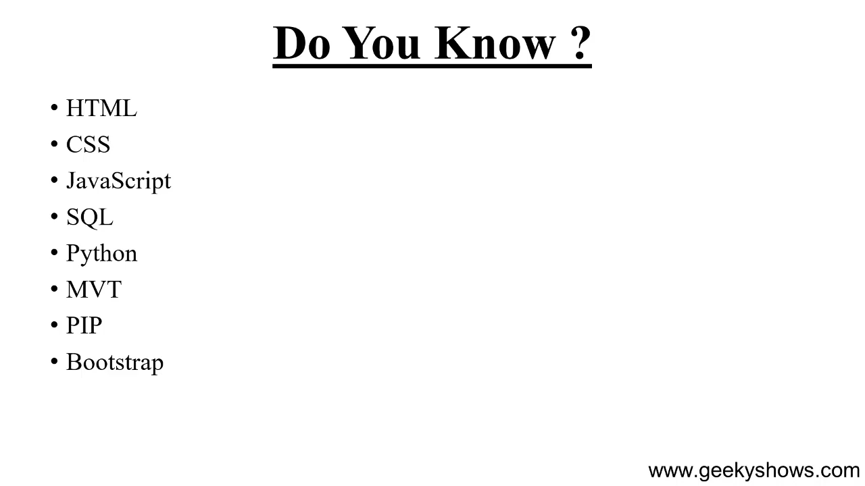

Slide 29
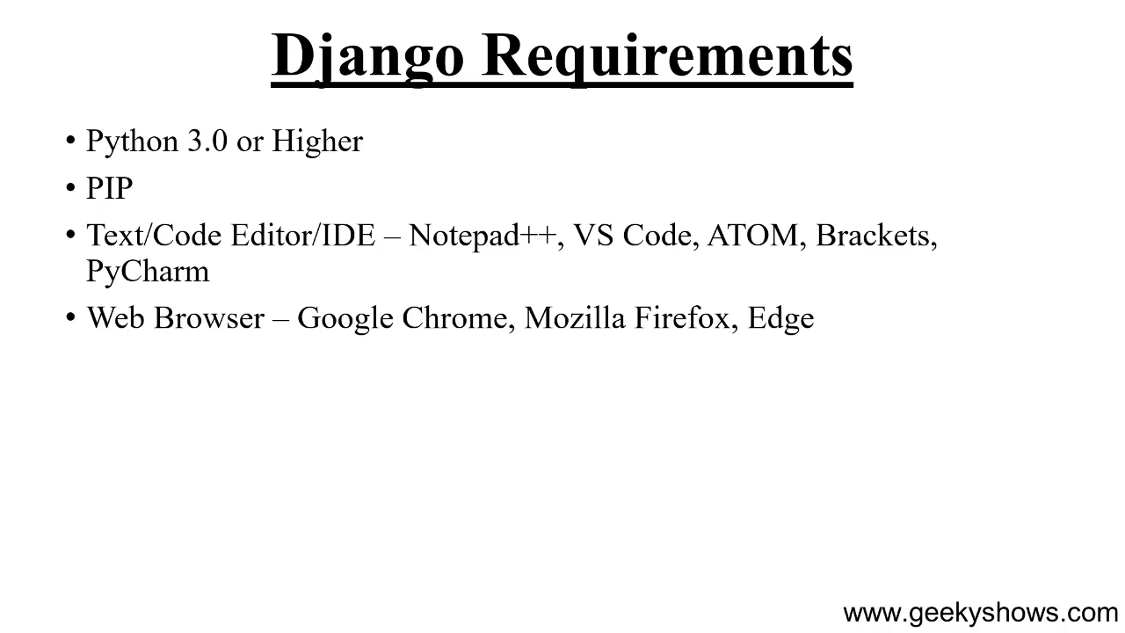

Slide 30
6. How to Install Django in Virtual Environment and Create Django Project

Slide 31
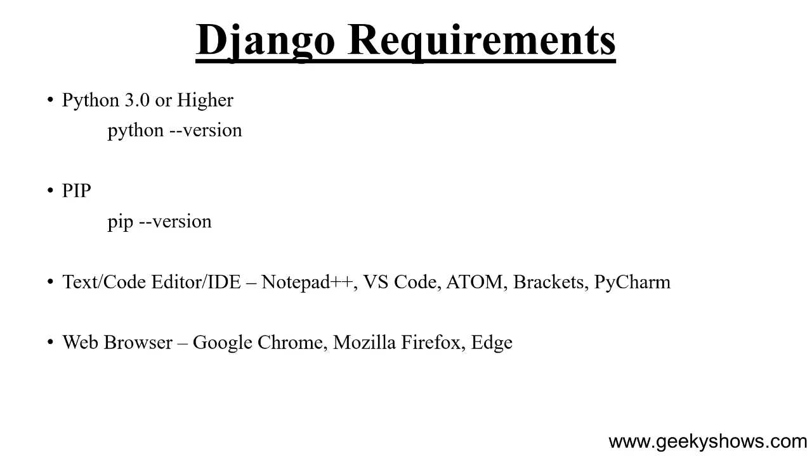

Slide 32
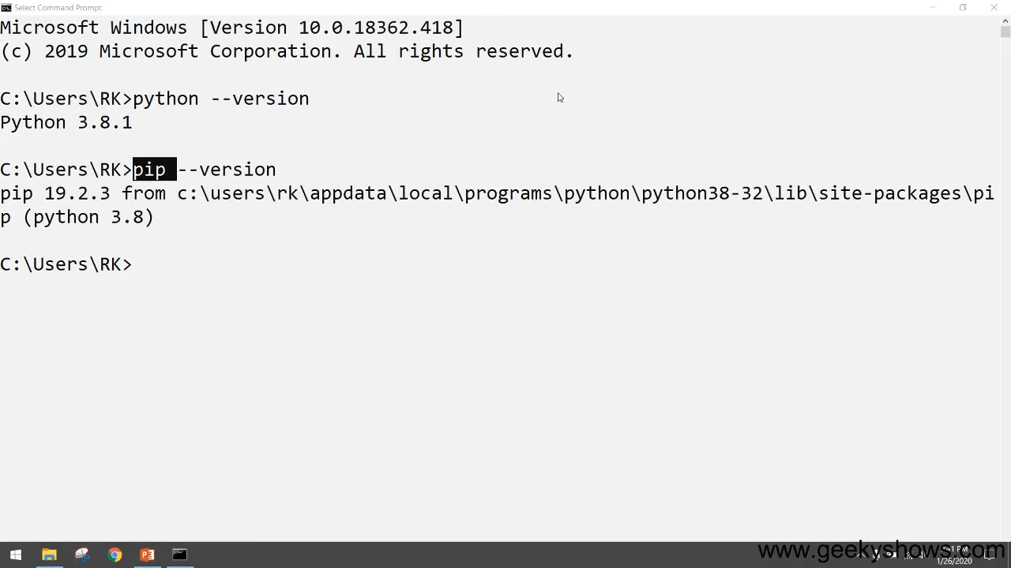

Slide 33
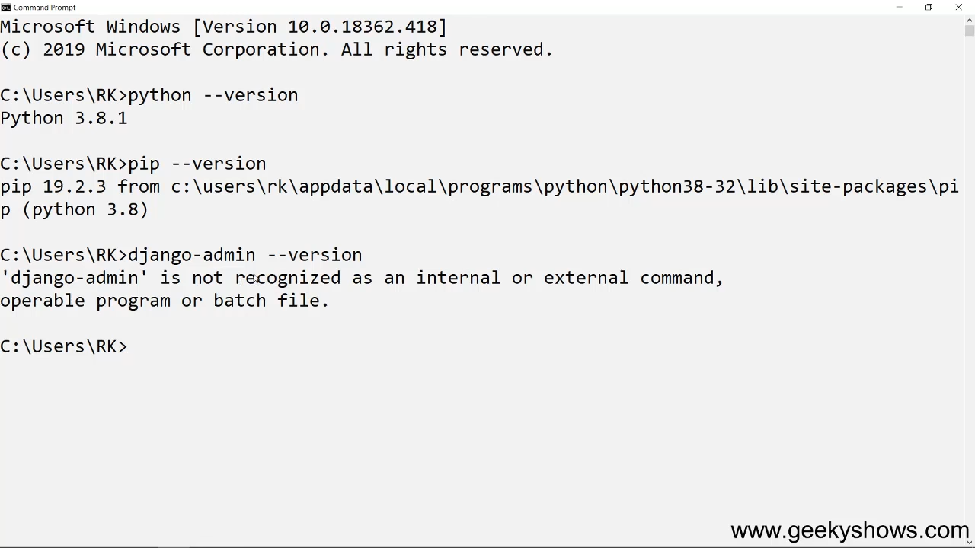

Slide 34
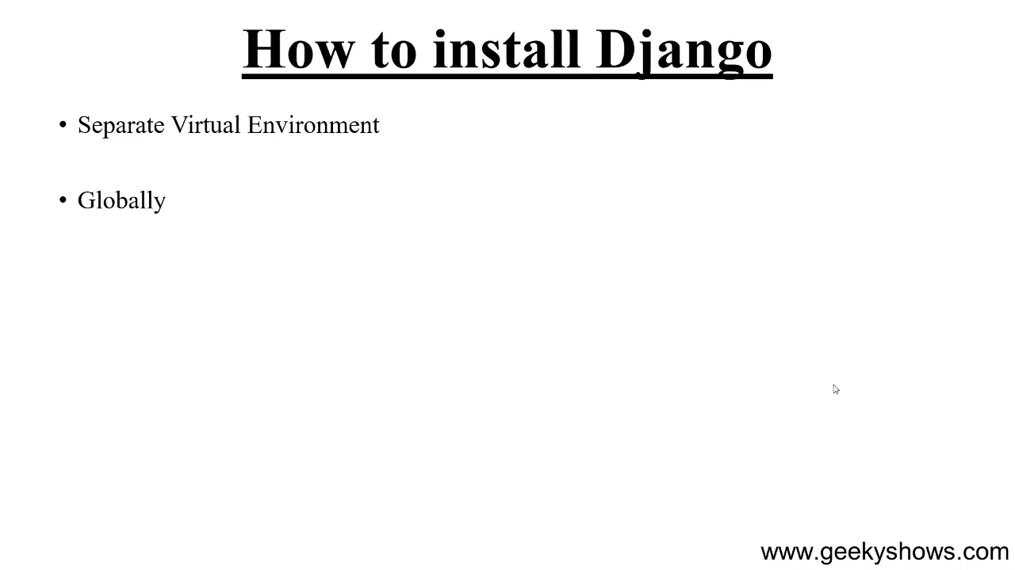

Slide 35
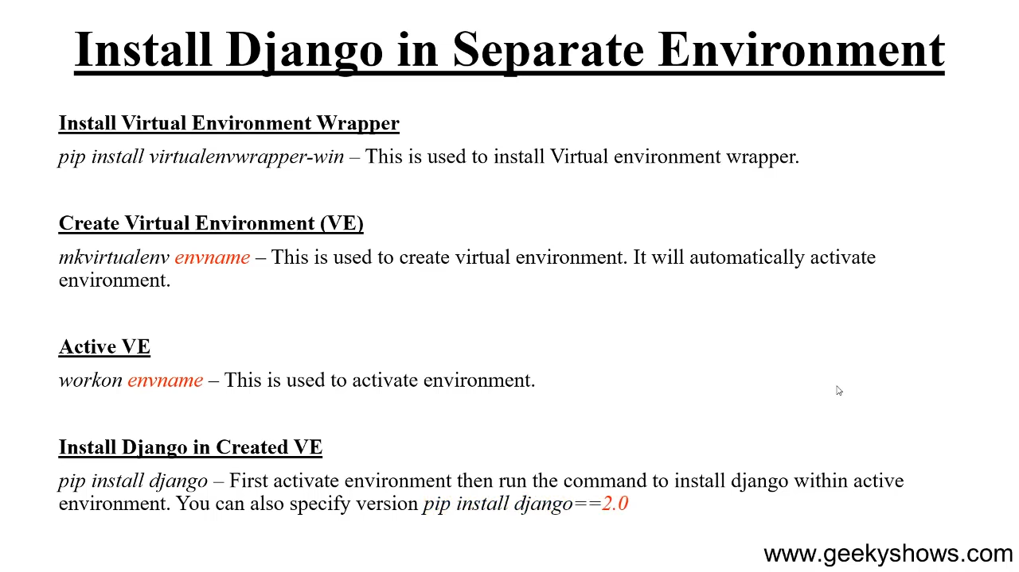

Slide 36
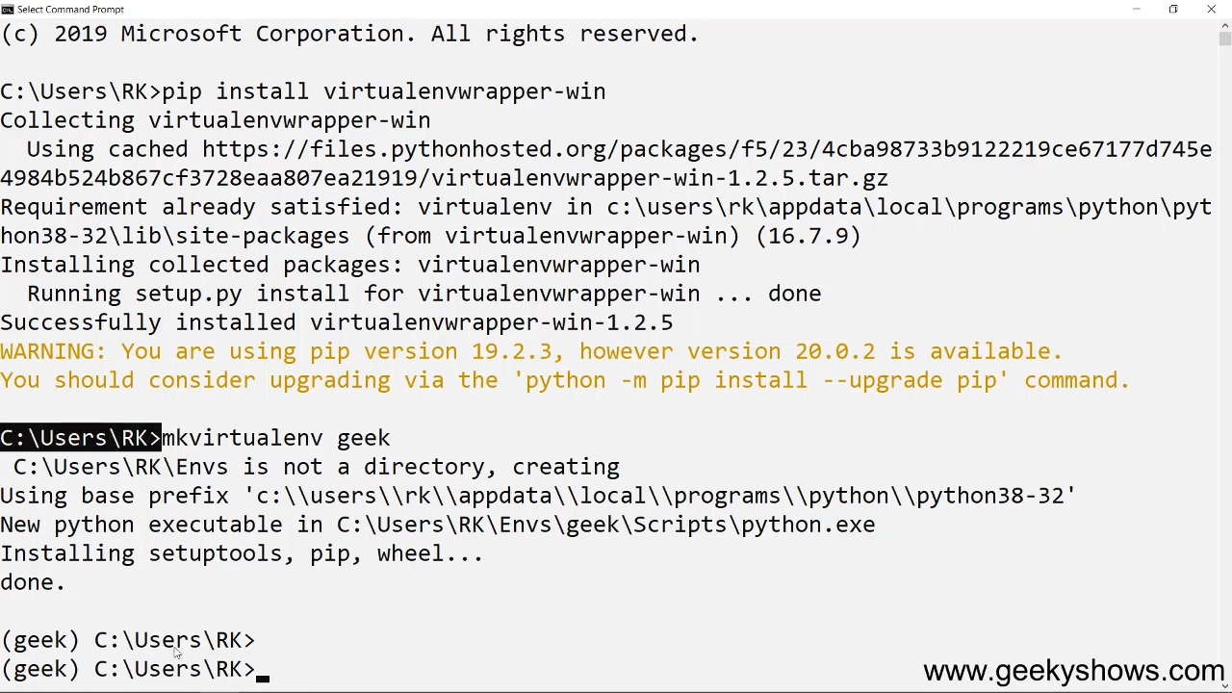

Slide 37
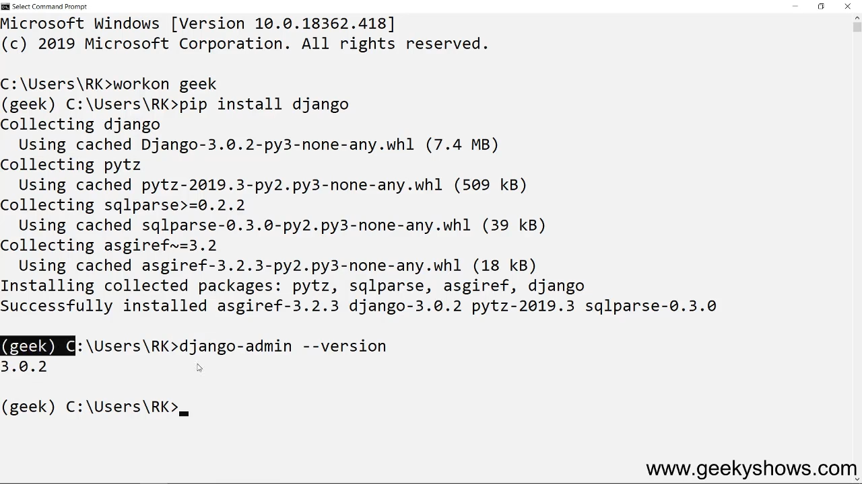

Slide 38
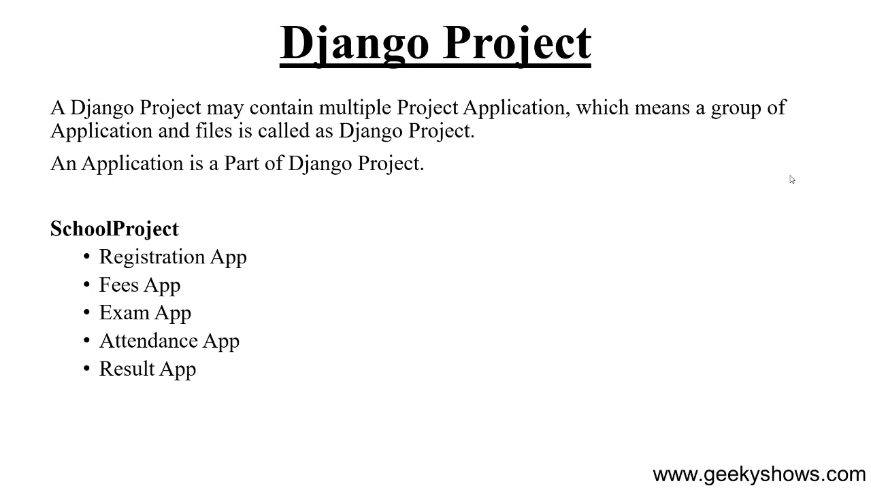

Slide 39
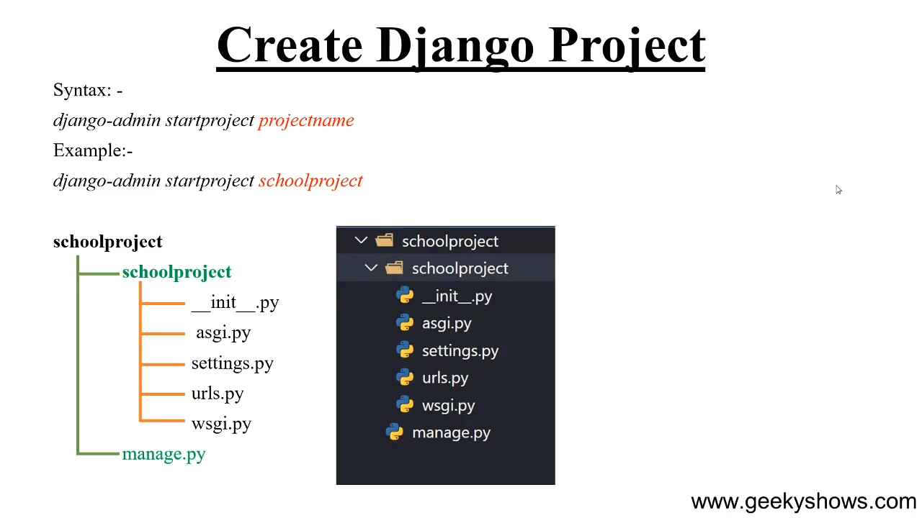

Slide 40
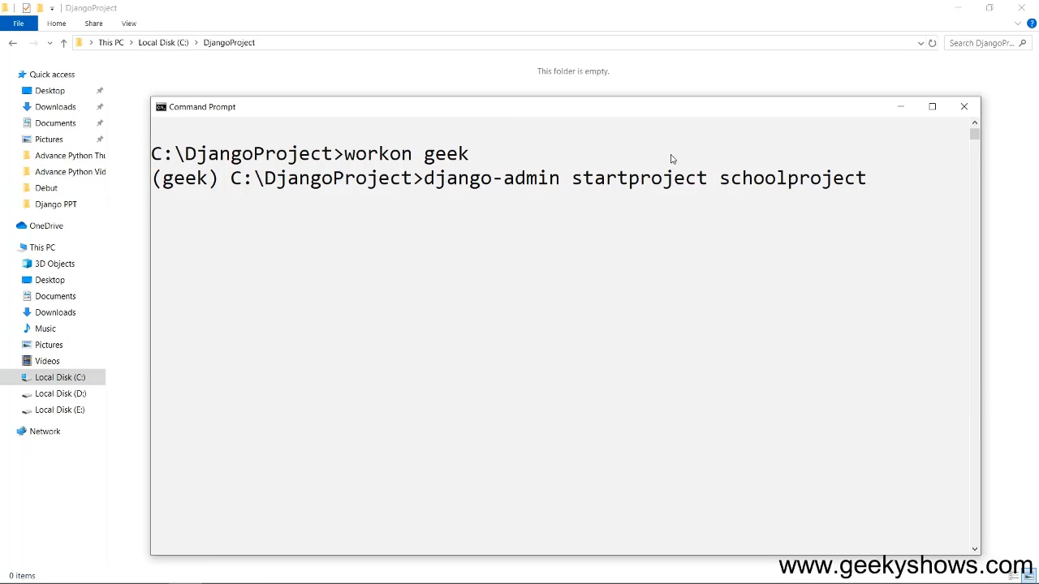

Slide 41
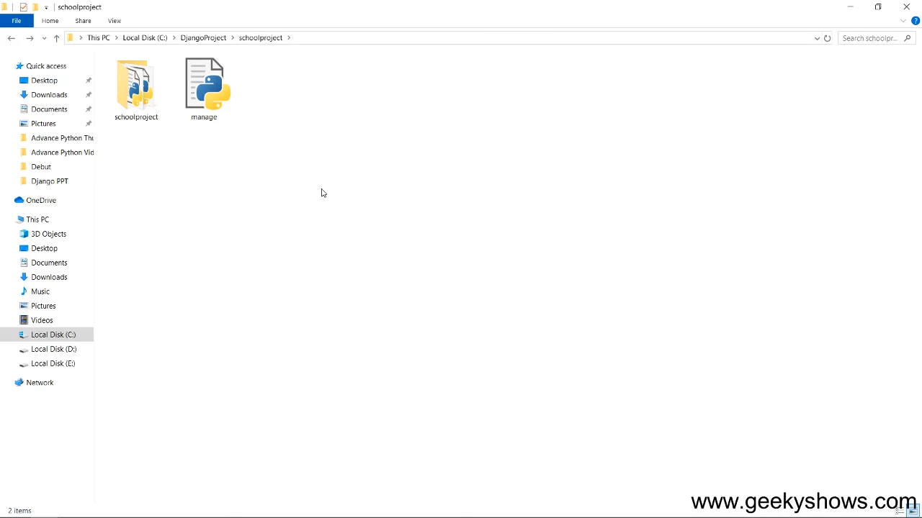

Slide 42
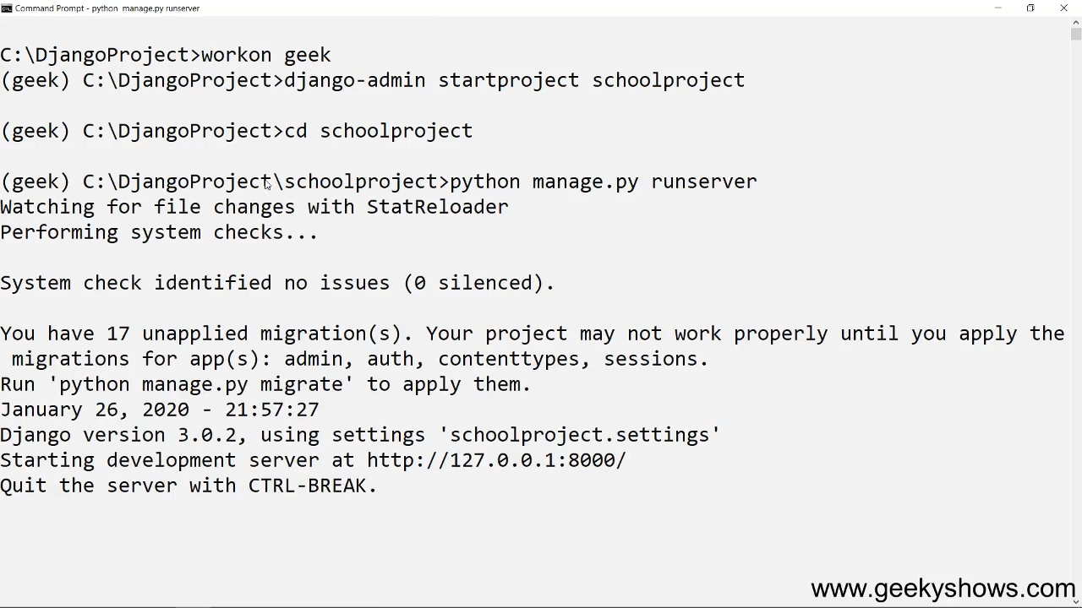

Slide 43
7. How to Uninstall Django from Separate Environment

Slide 44
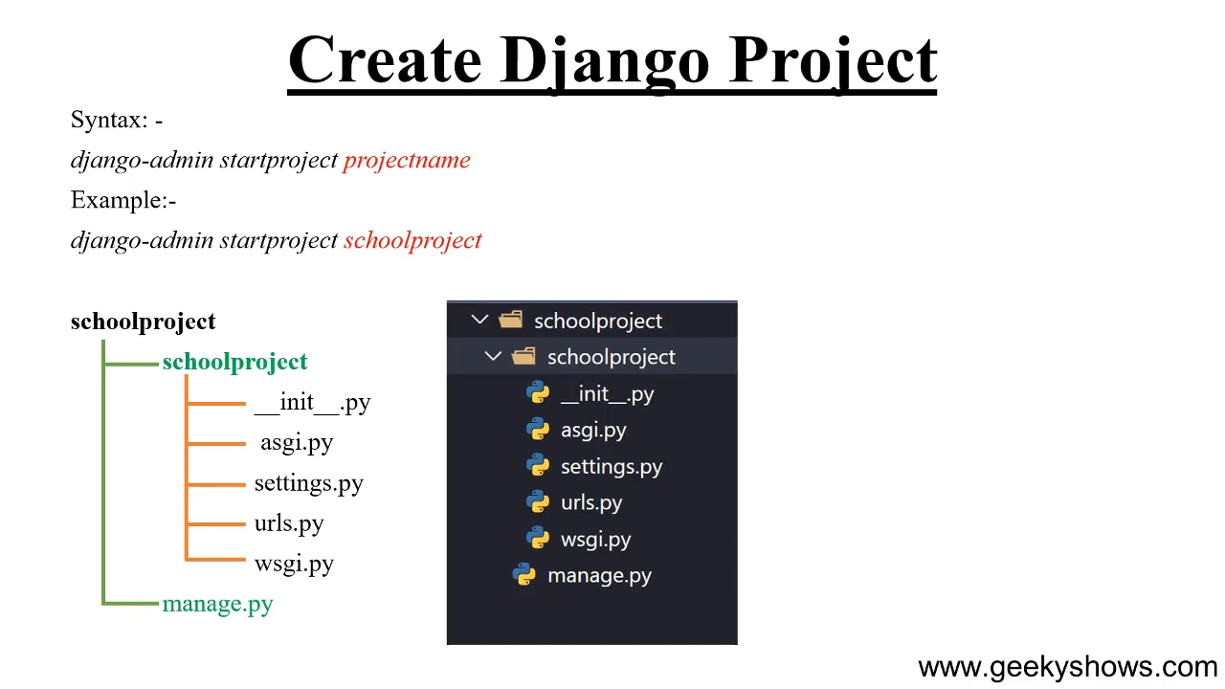

Slide 45
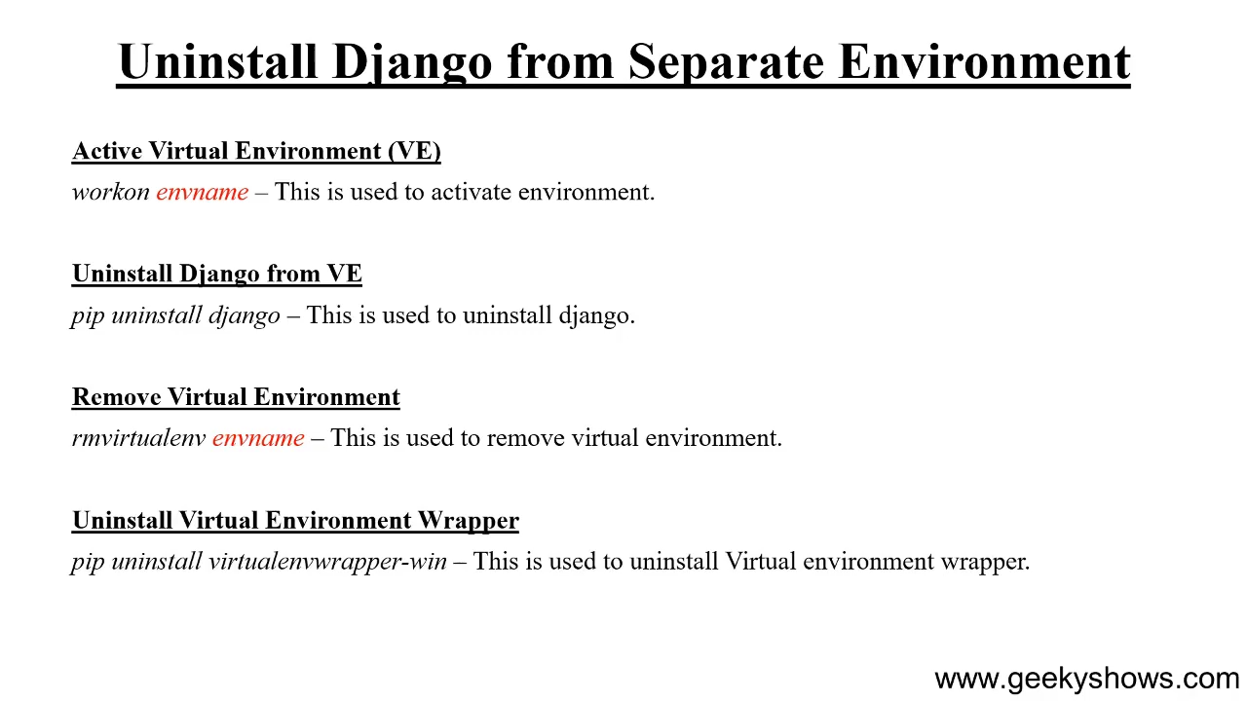

Slide 46
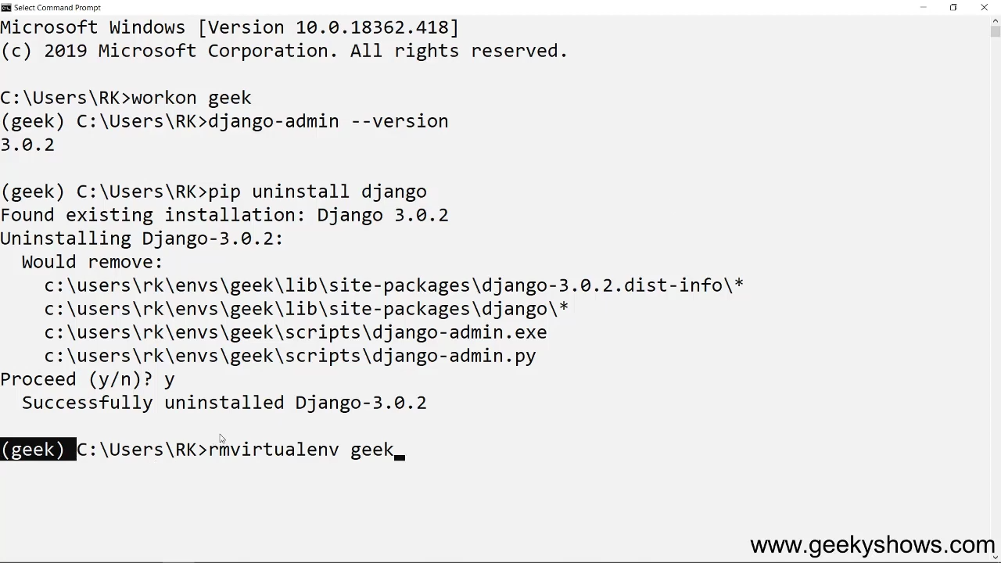

Slide 47
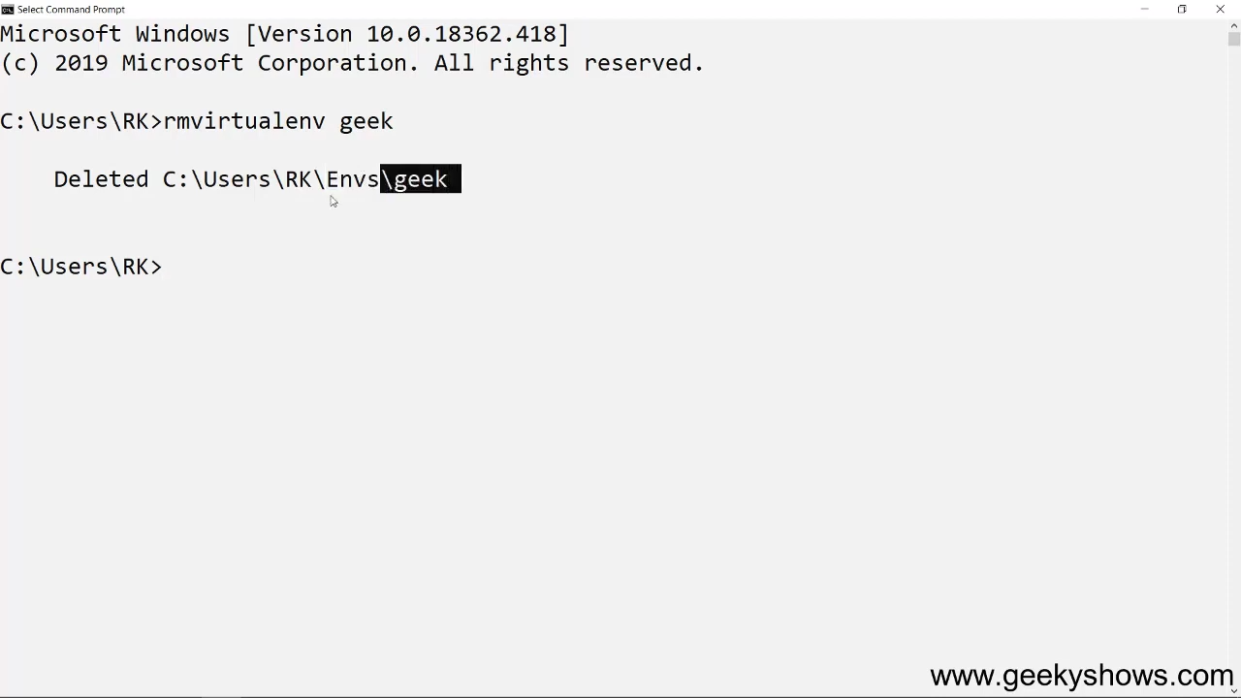

Slide 48
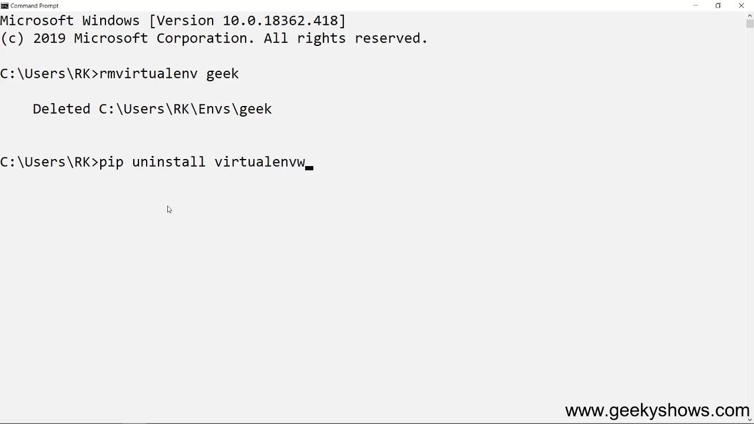

Slide 49
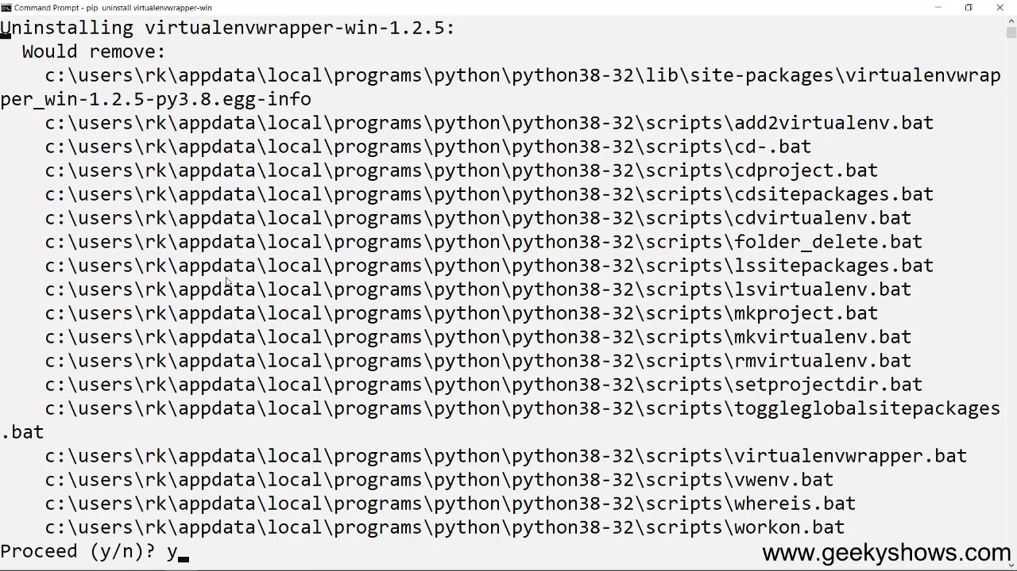

Slide 50
8. How to Install Django Globally and Create Django Project

Slide 51


Slide 52
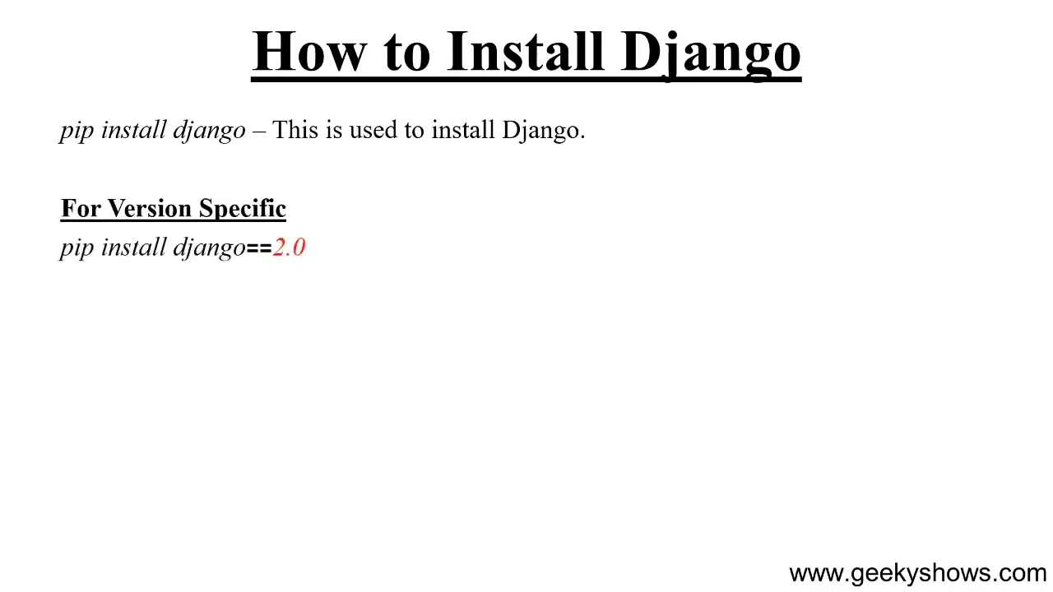

Slide 53
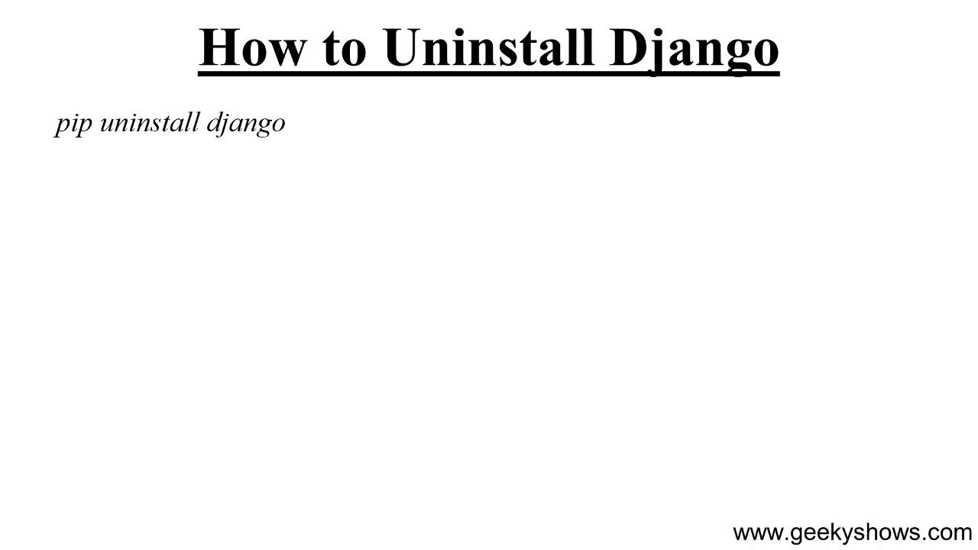

Slide 54
9. Django Project Directory Structure

Slide 55
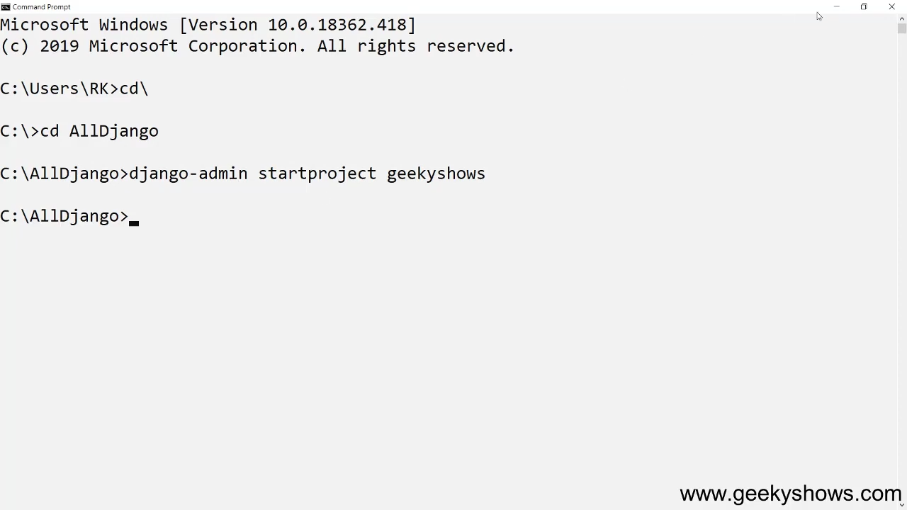

Slide 56
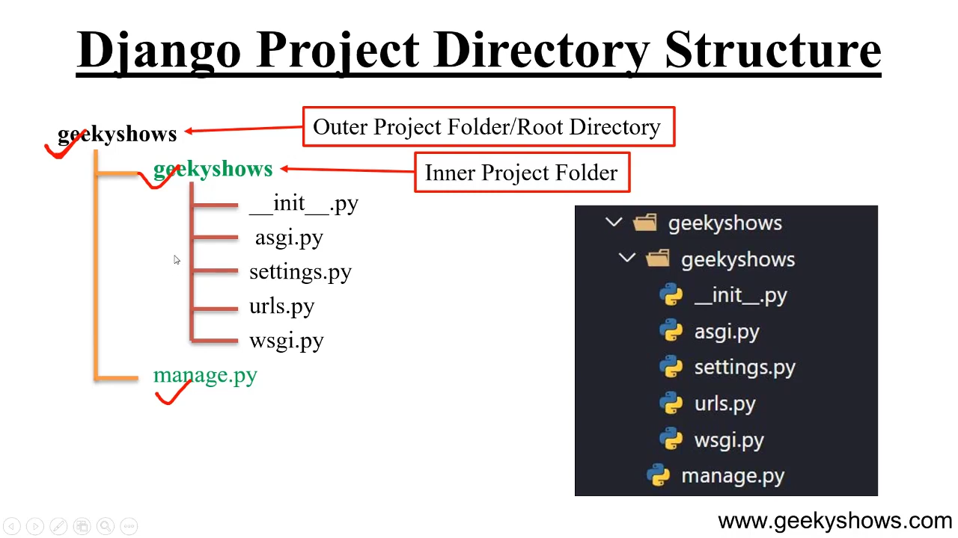

Slide 57
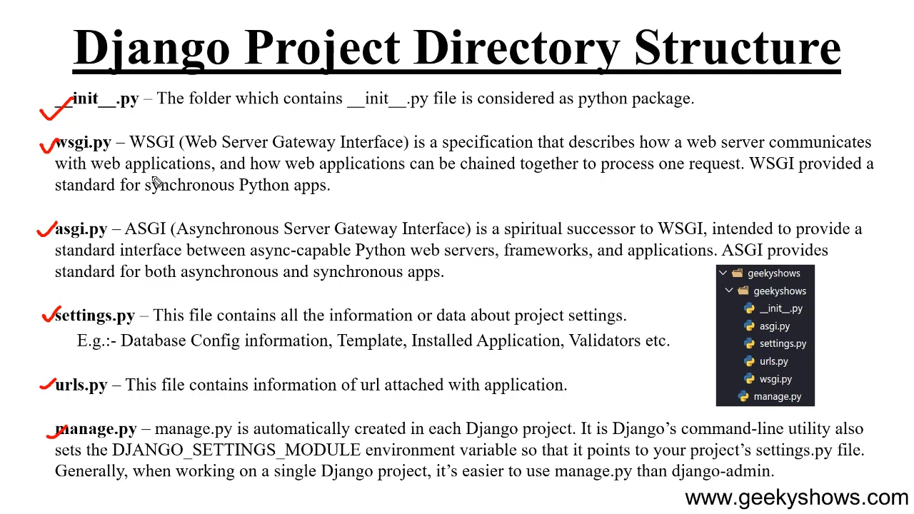

Slide 58
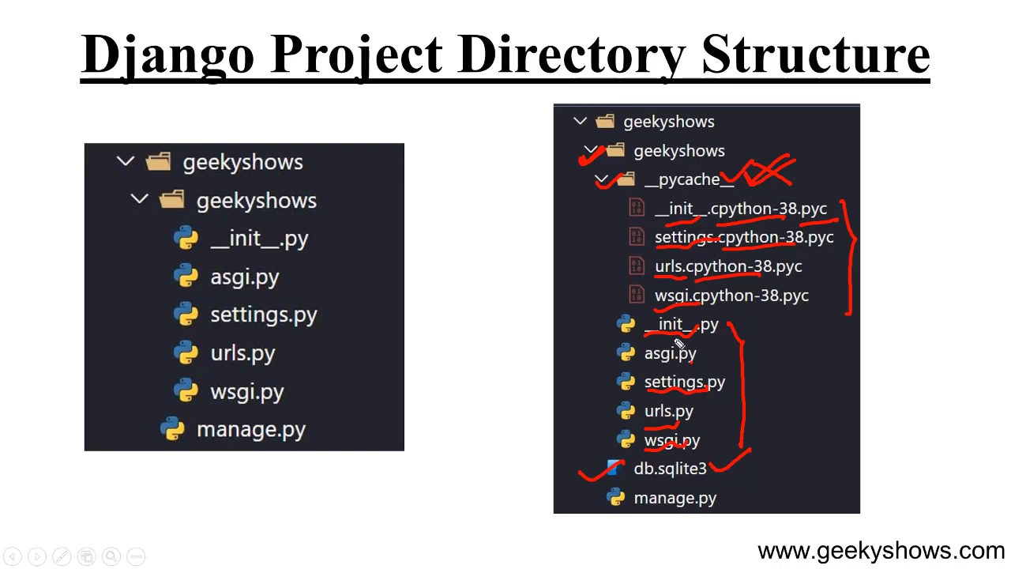

Slide 59
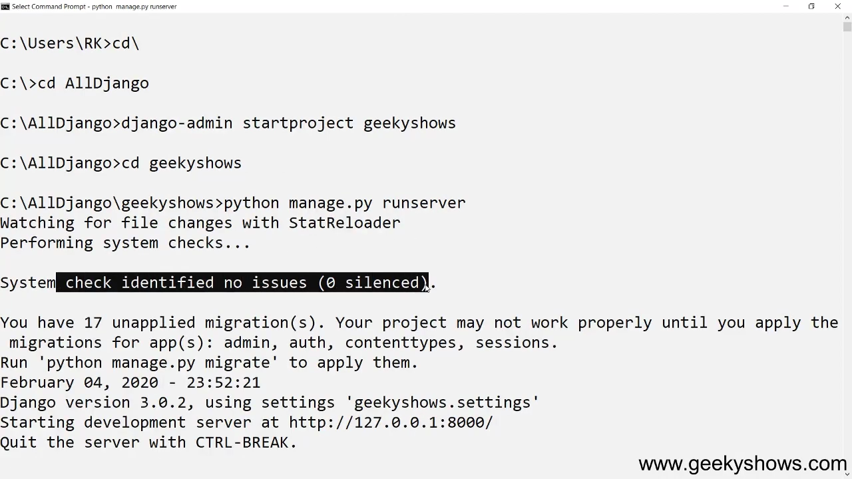

Slide 60
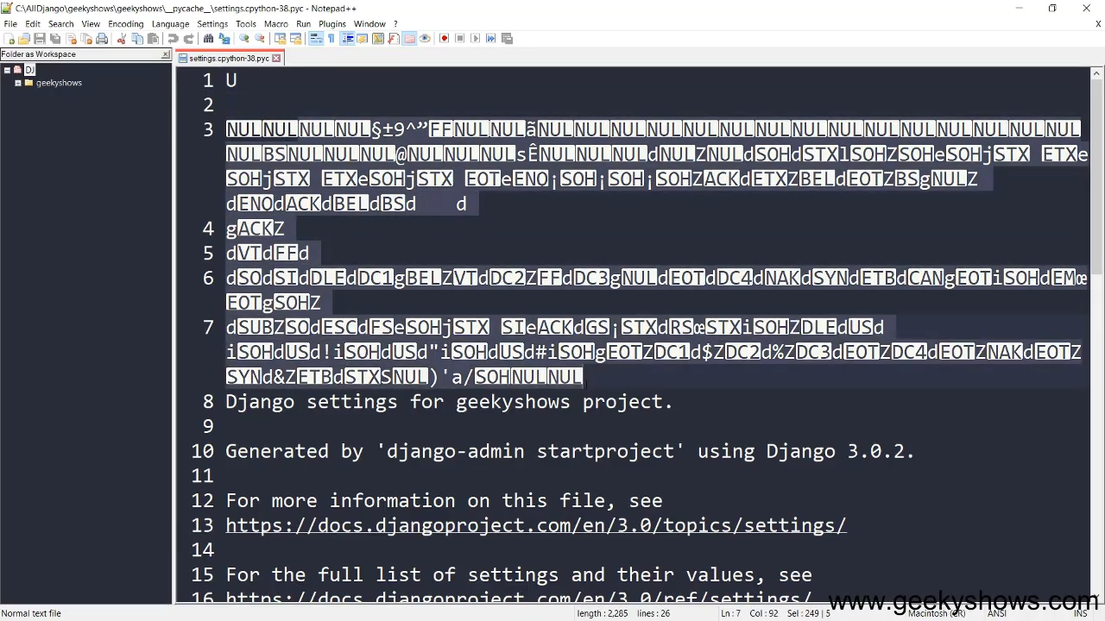

Slide 61
10. init wsgi and asgi Files in Django

Slide 62
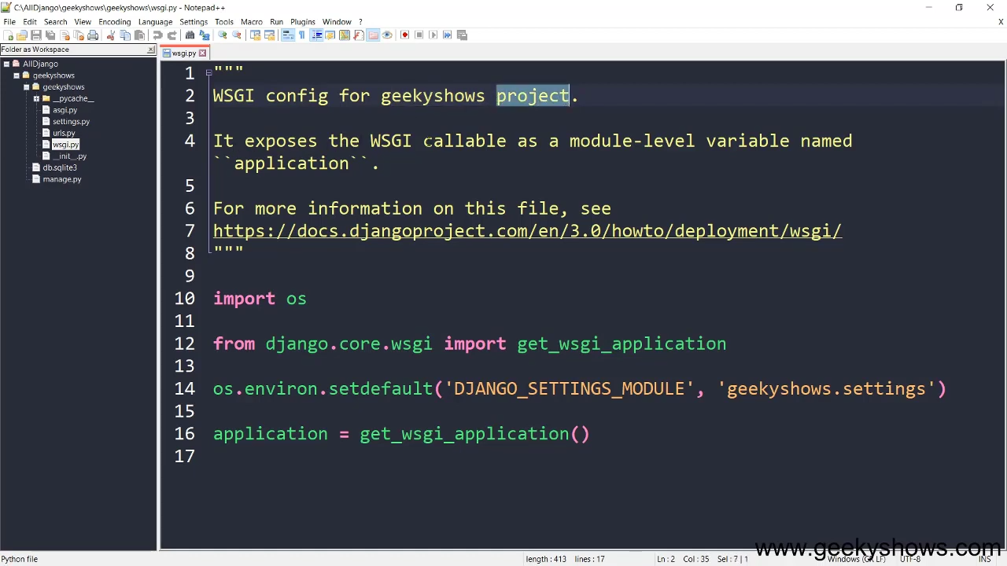

Slide 63


Slide 64


Slide 65


Slide 66


Slide 67


Slide 68
11. settings File in Django

Slide 69


Slide 70


Slide 71


Slide 72


Slide 73


Slide 74


Slide 75


Slide 76


Slide 77


Slide 78


Slide 79


Slide 80


Slide 81


Slide 82
12. urls and manage File in Django

Slide 83


Slide 84


Slide 85
13. How to Run and Stop Server in Django

Slide 86


Slide 87


Slide 88
14. Problems and their Solutions While Learning Django

Slide 89


Slide 90
15. How to Create and Install Application in Django

Slide 91


Slide 92


Slide 93


Slide 94


Slide 95


Slide 96


Slide 97


Slide 98


Slide 99


Slide 100


Slide 101


Slide 102
16. Application Directory Structure in Django

Slide 103


Slide 104


Slide 105
17. Create Function Based View in Django

Slide 106


Slide 107


Slide 108


Slide 109


Slide 110


Slide 111


Slide 112


Slide 113


Slide 114


Slide 115


Slide 116


Slide 117


Slide 118


Slide 119


Slide 120


Slide 121
18. URL Dispatcher or URL Pattern inside Project in Django

Slide 122


Slide 123


Slide 124


Slide 125


Slide 126


Slide 127


Slide 128


Slide 129


